Slide 1
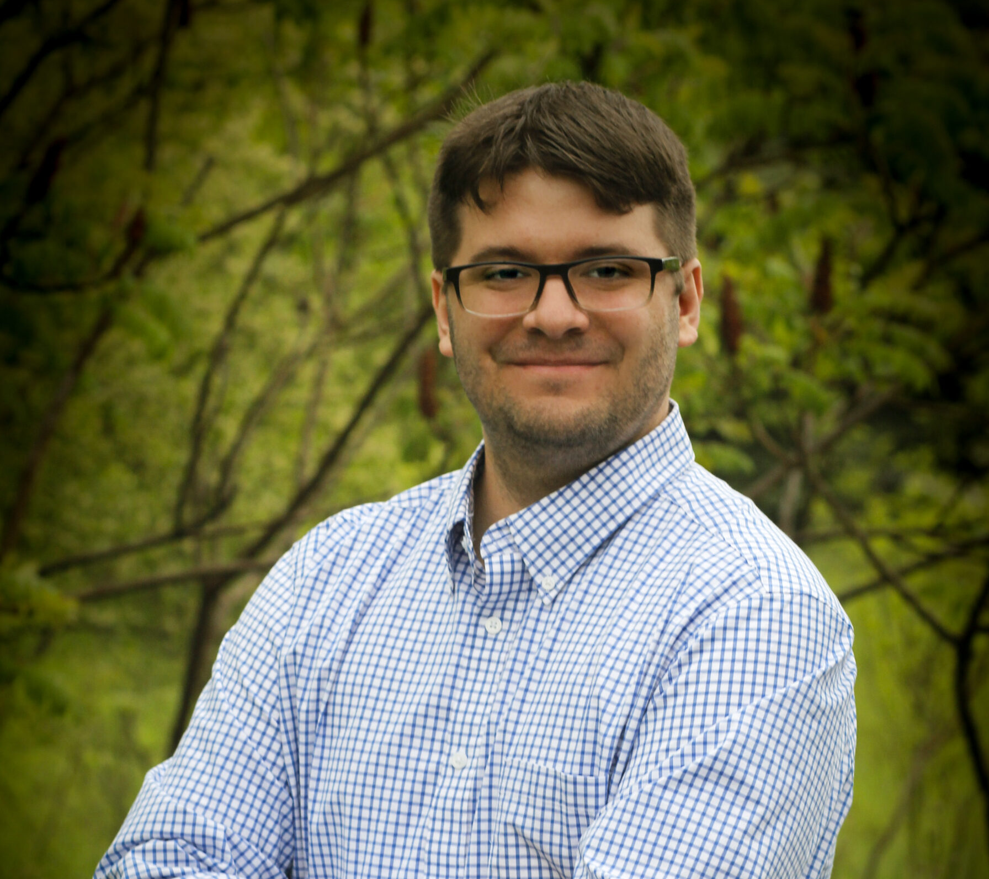
Patrick Rorick
Community Development Planner
Region 3-A

Slide 2
About Me
I am from Fort Wayne, Indiana
I enjoy traveling, reading, and writing
I love learning about new places and events to attend
Graduated from Bishop Luers High School - 2016
Graduated from Purdue University Fort Wayne (IPFW)- 2020
Bachelor of Science in Public Affairs

Slide 3
Region 3-A
Region 3-A supports the community and economic development of 6 counties and 32 municipalities.
Huntington, LaGrange, Noble, Steuben, Wabash, and Whitely Counties
Examples of services include:
Community and economic development assistance
Park Planning
Grant writing and administration
Comprehensive plans
Technical GIS and transportation assistance

Slide 4

Contact Information
Please feel free to contact me at prorick@region3A.org

