Slide 1
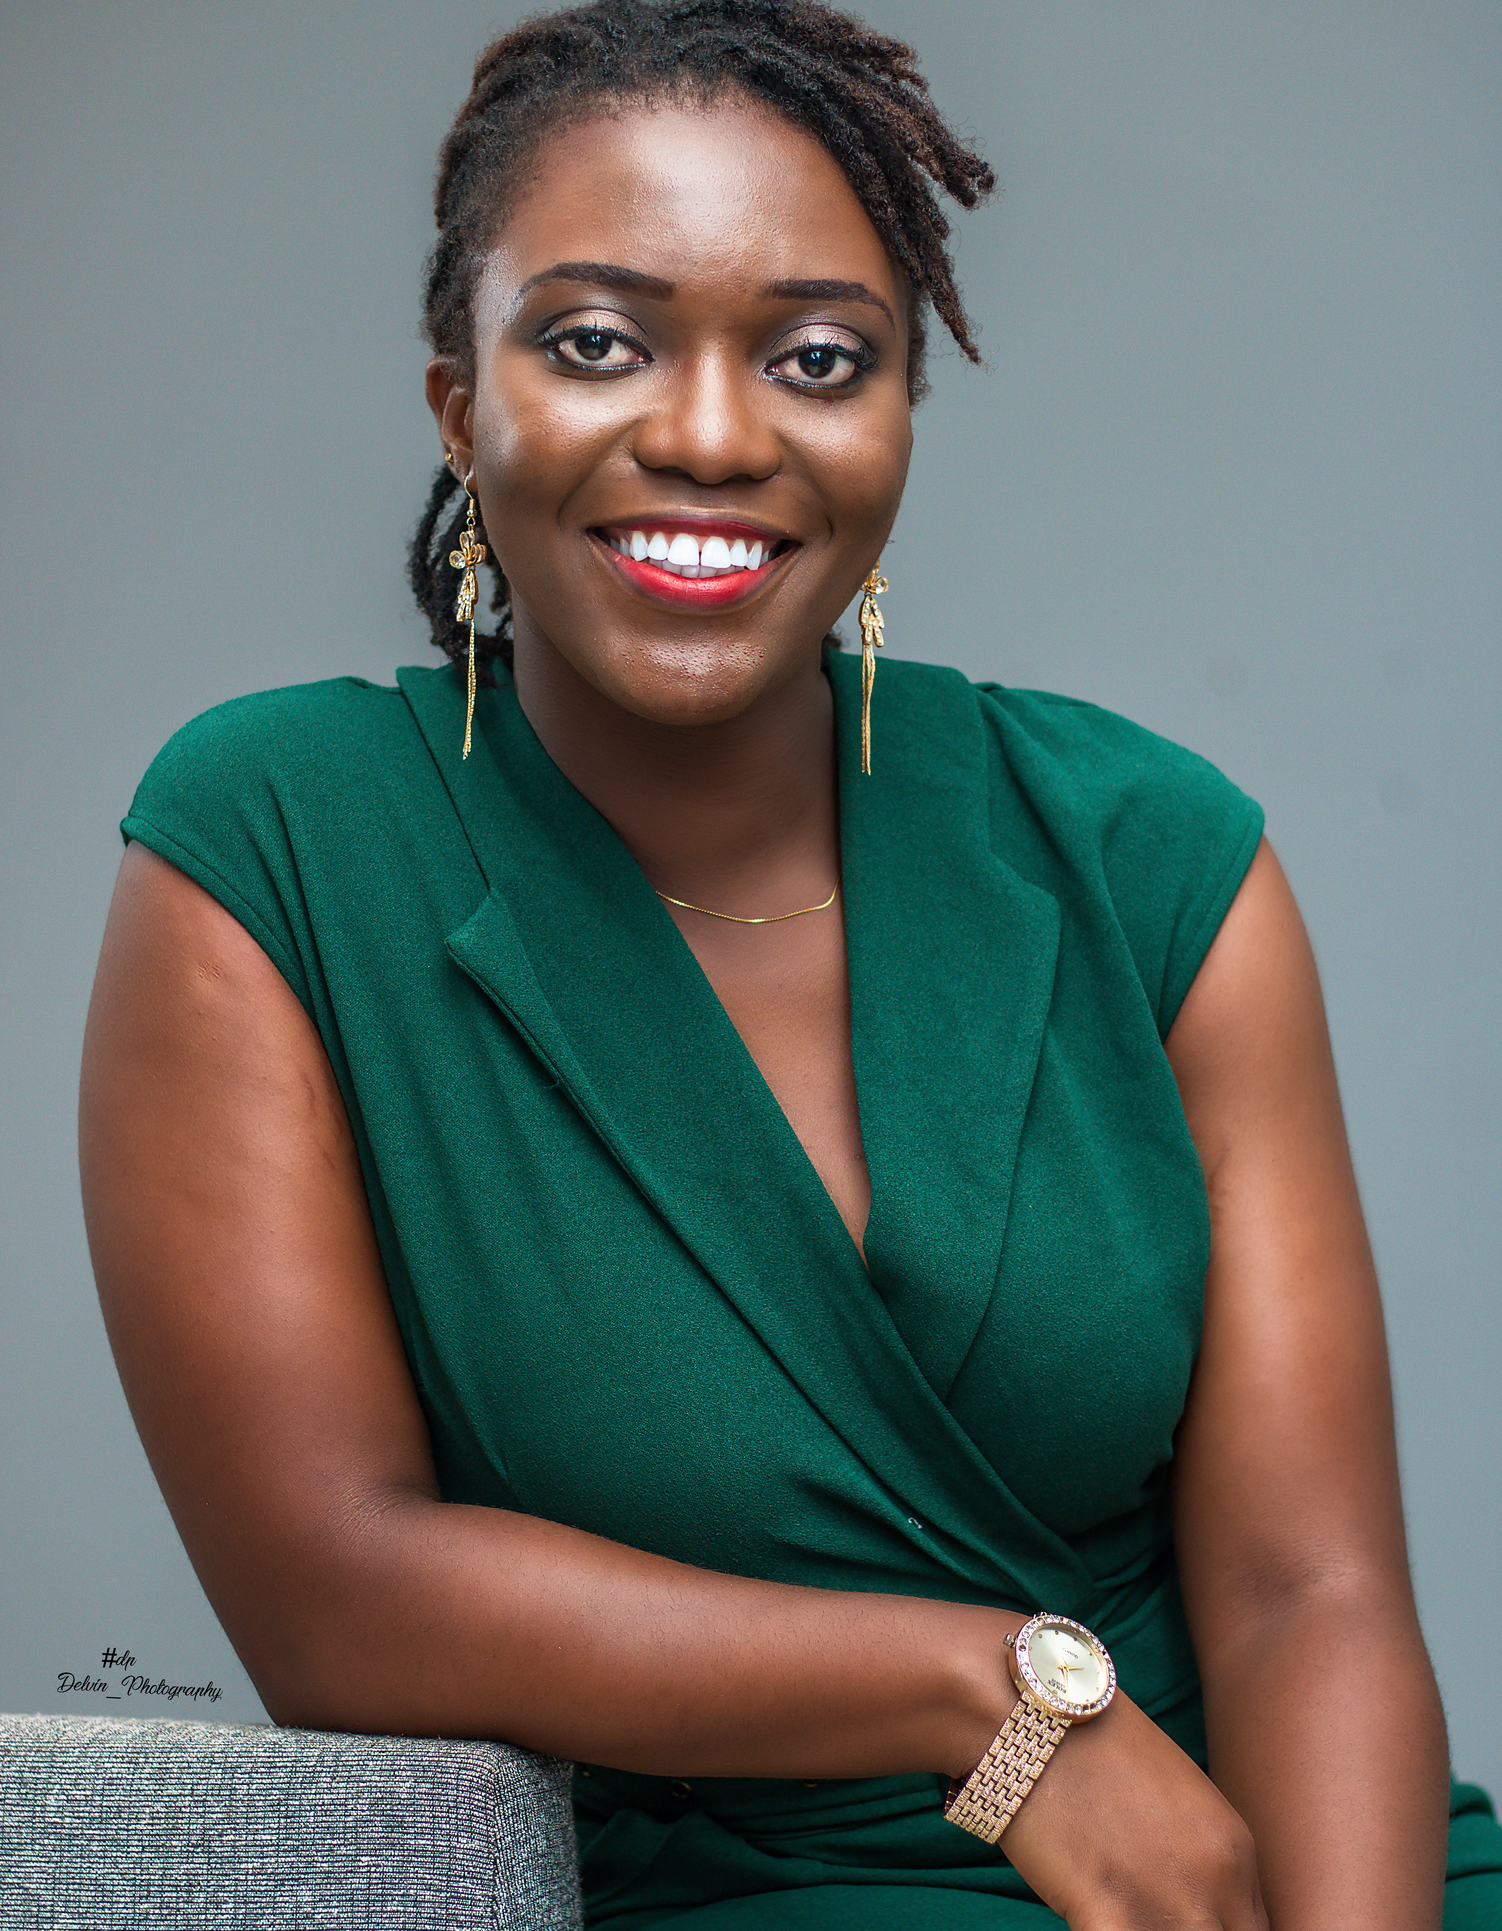
MEET ME
Lyzbeth Safoah King

Slide 2

Affiliations
Purdue University – Fort Wayne, MA Professional Communication/Graduate Teaching Assistant
Noble County Conventions and Visitors Bureau, Albion – Summer Intern
National Communication Association – Student member
International Communication Association – Student member
Central States Communication Association – Student member

Slide 3

Country Of Origin
Ghana, West Africa

Slide 4
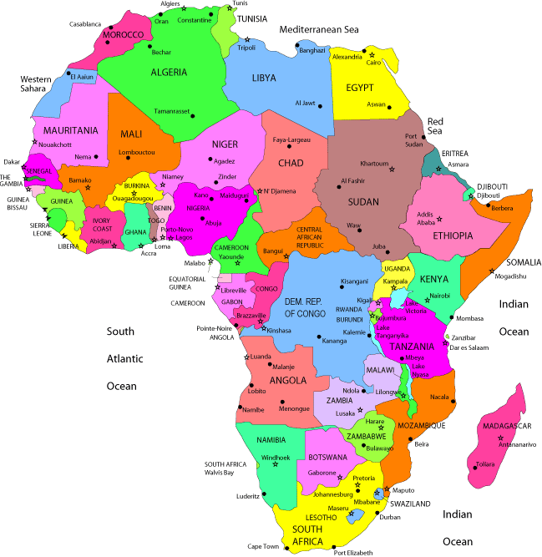
Continent
Africa

Slide 5
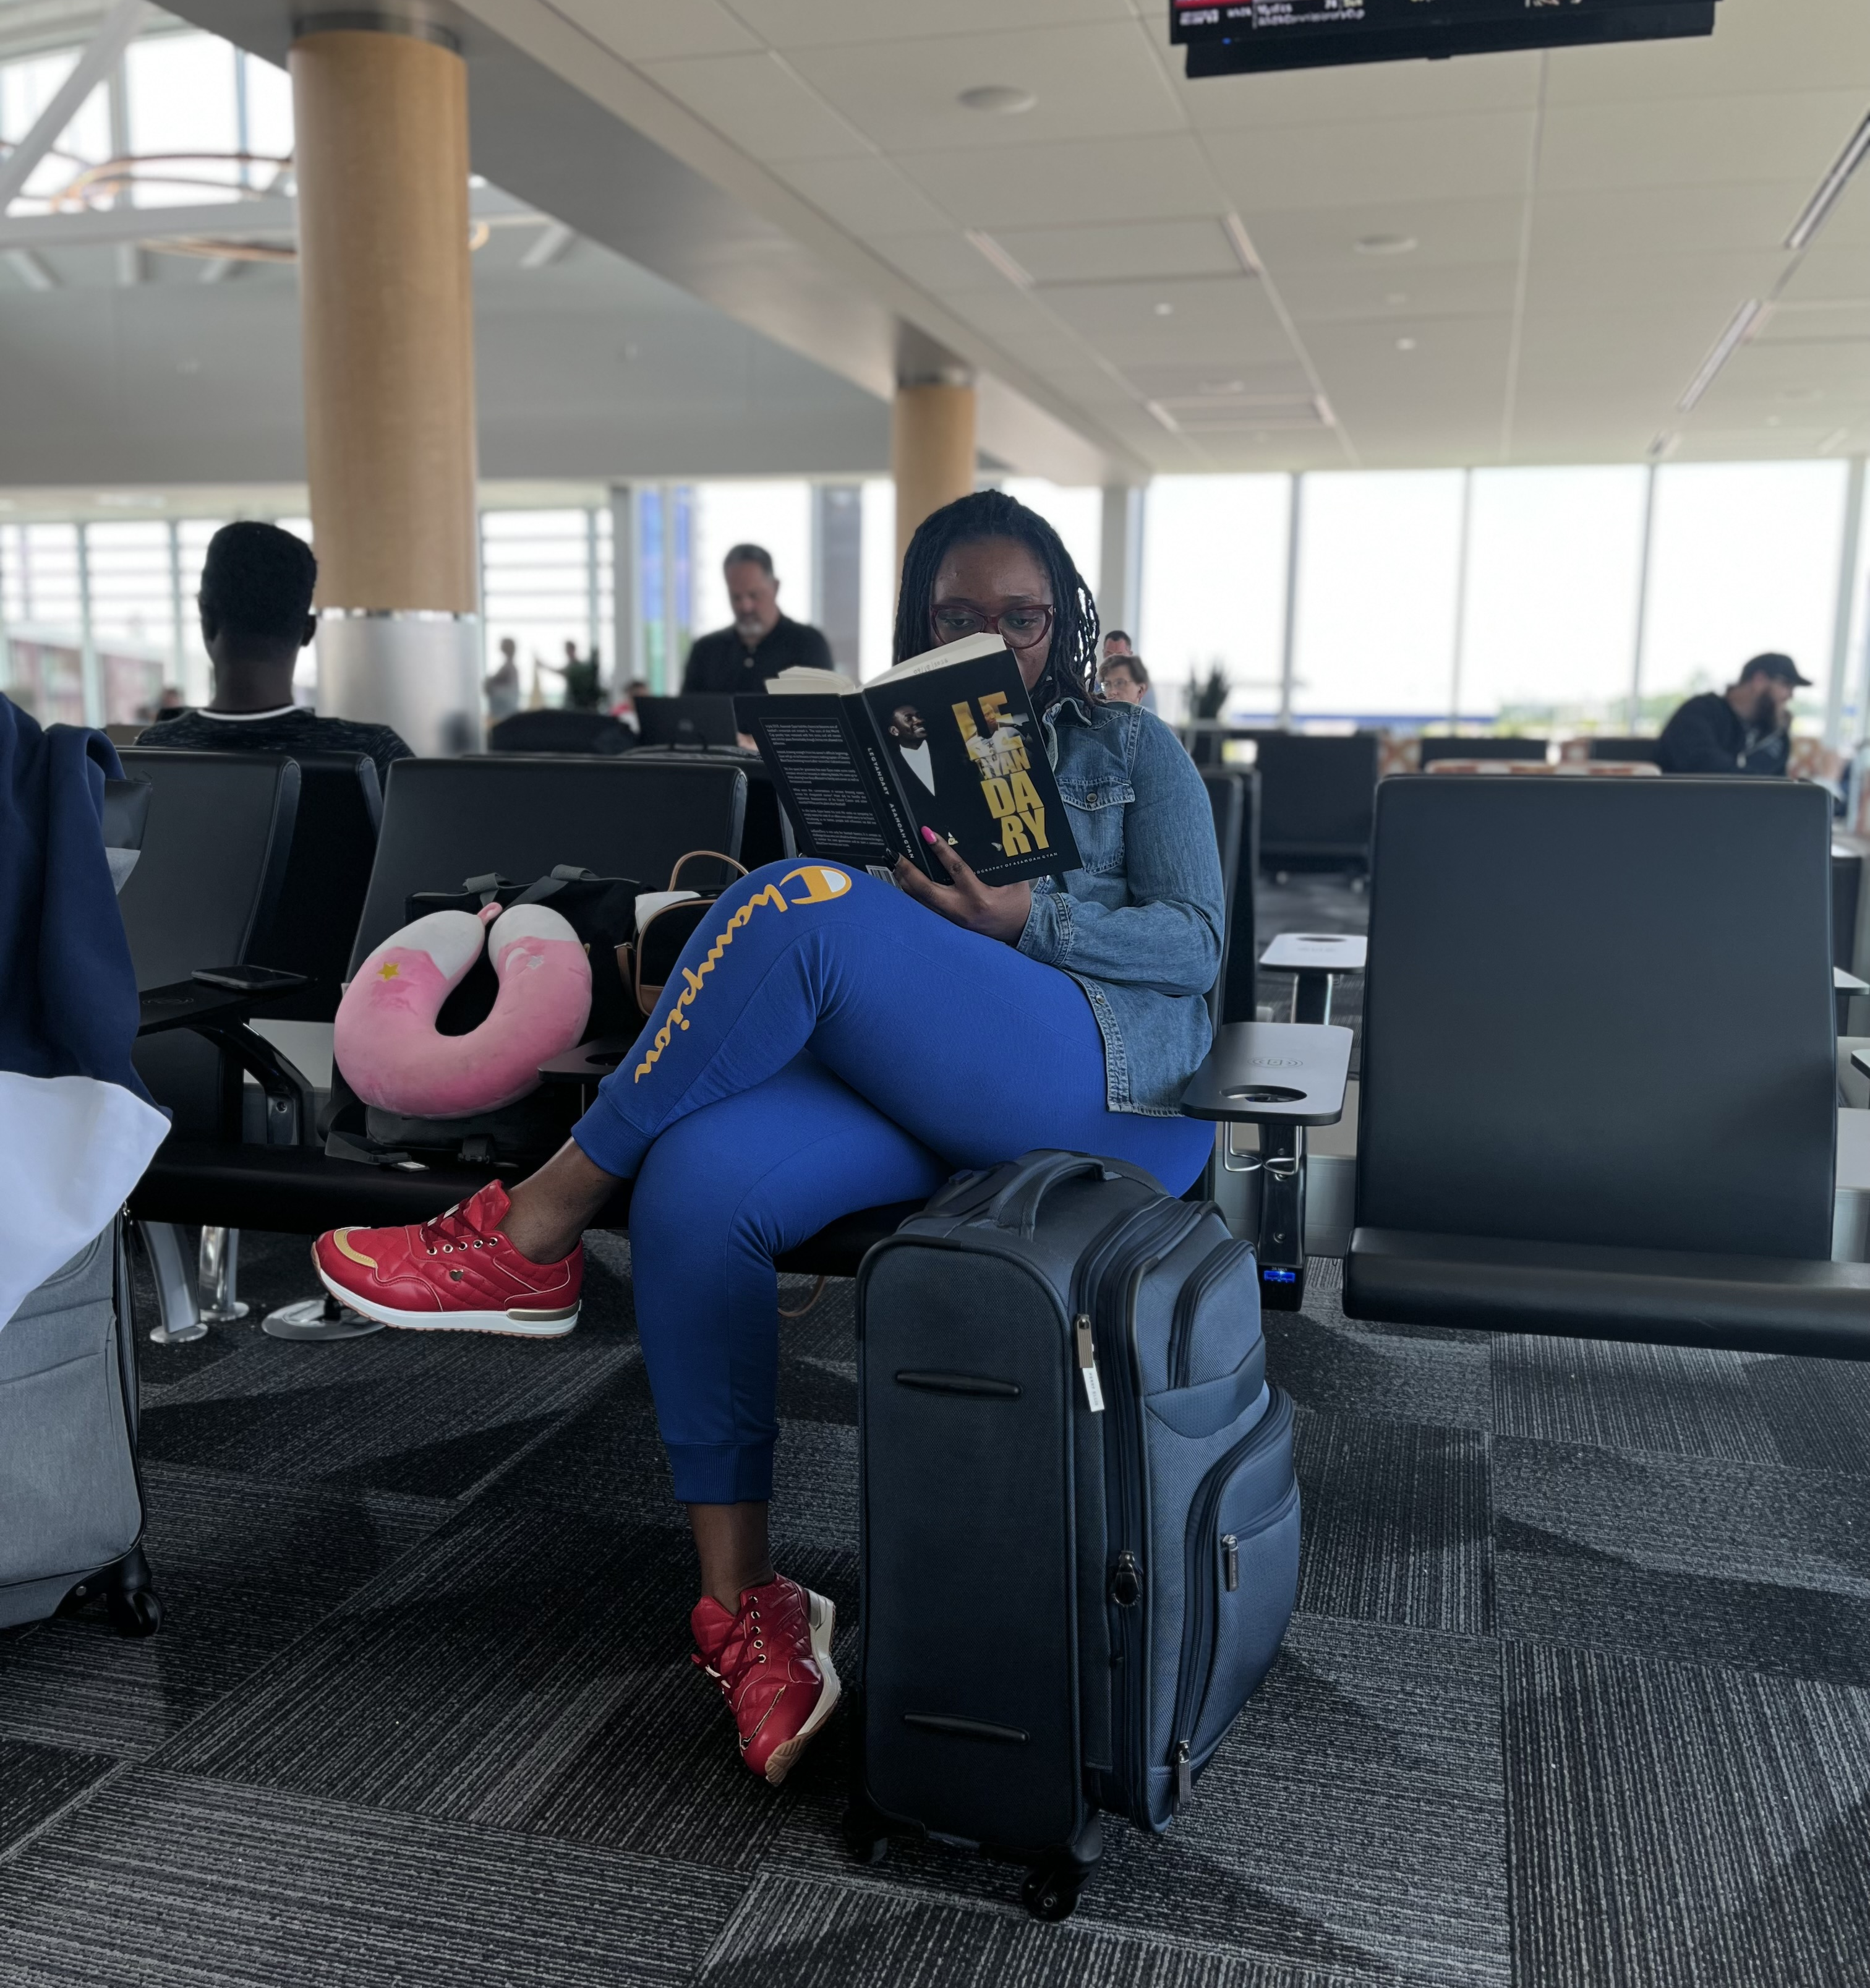
Outside the Classroom/Workspace
Spending time with family and friends
Reading for fun
Sightseeing

Slide 6
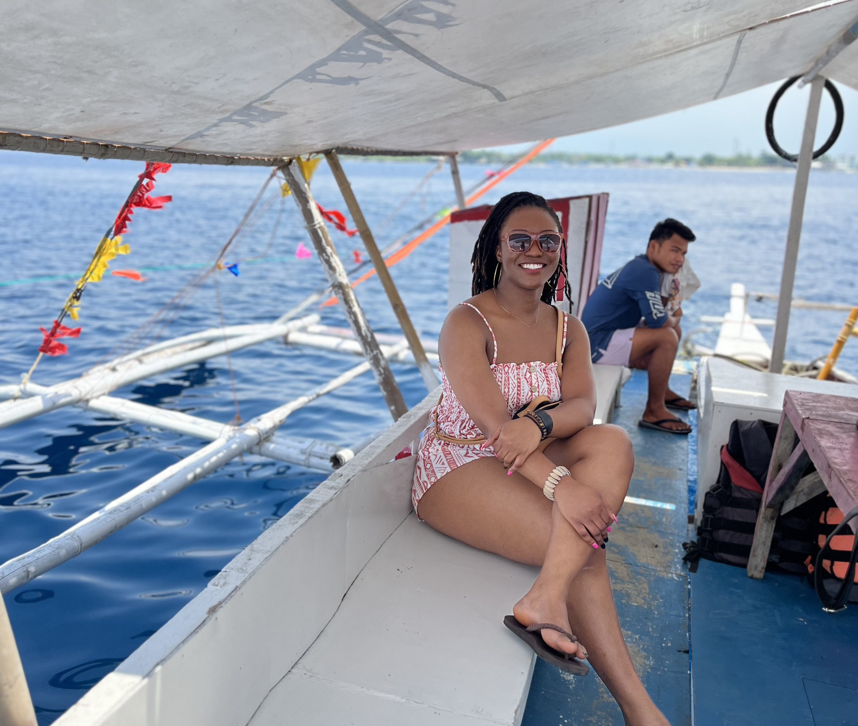
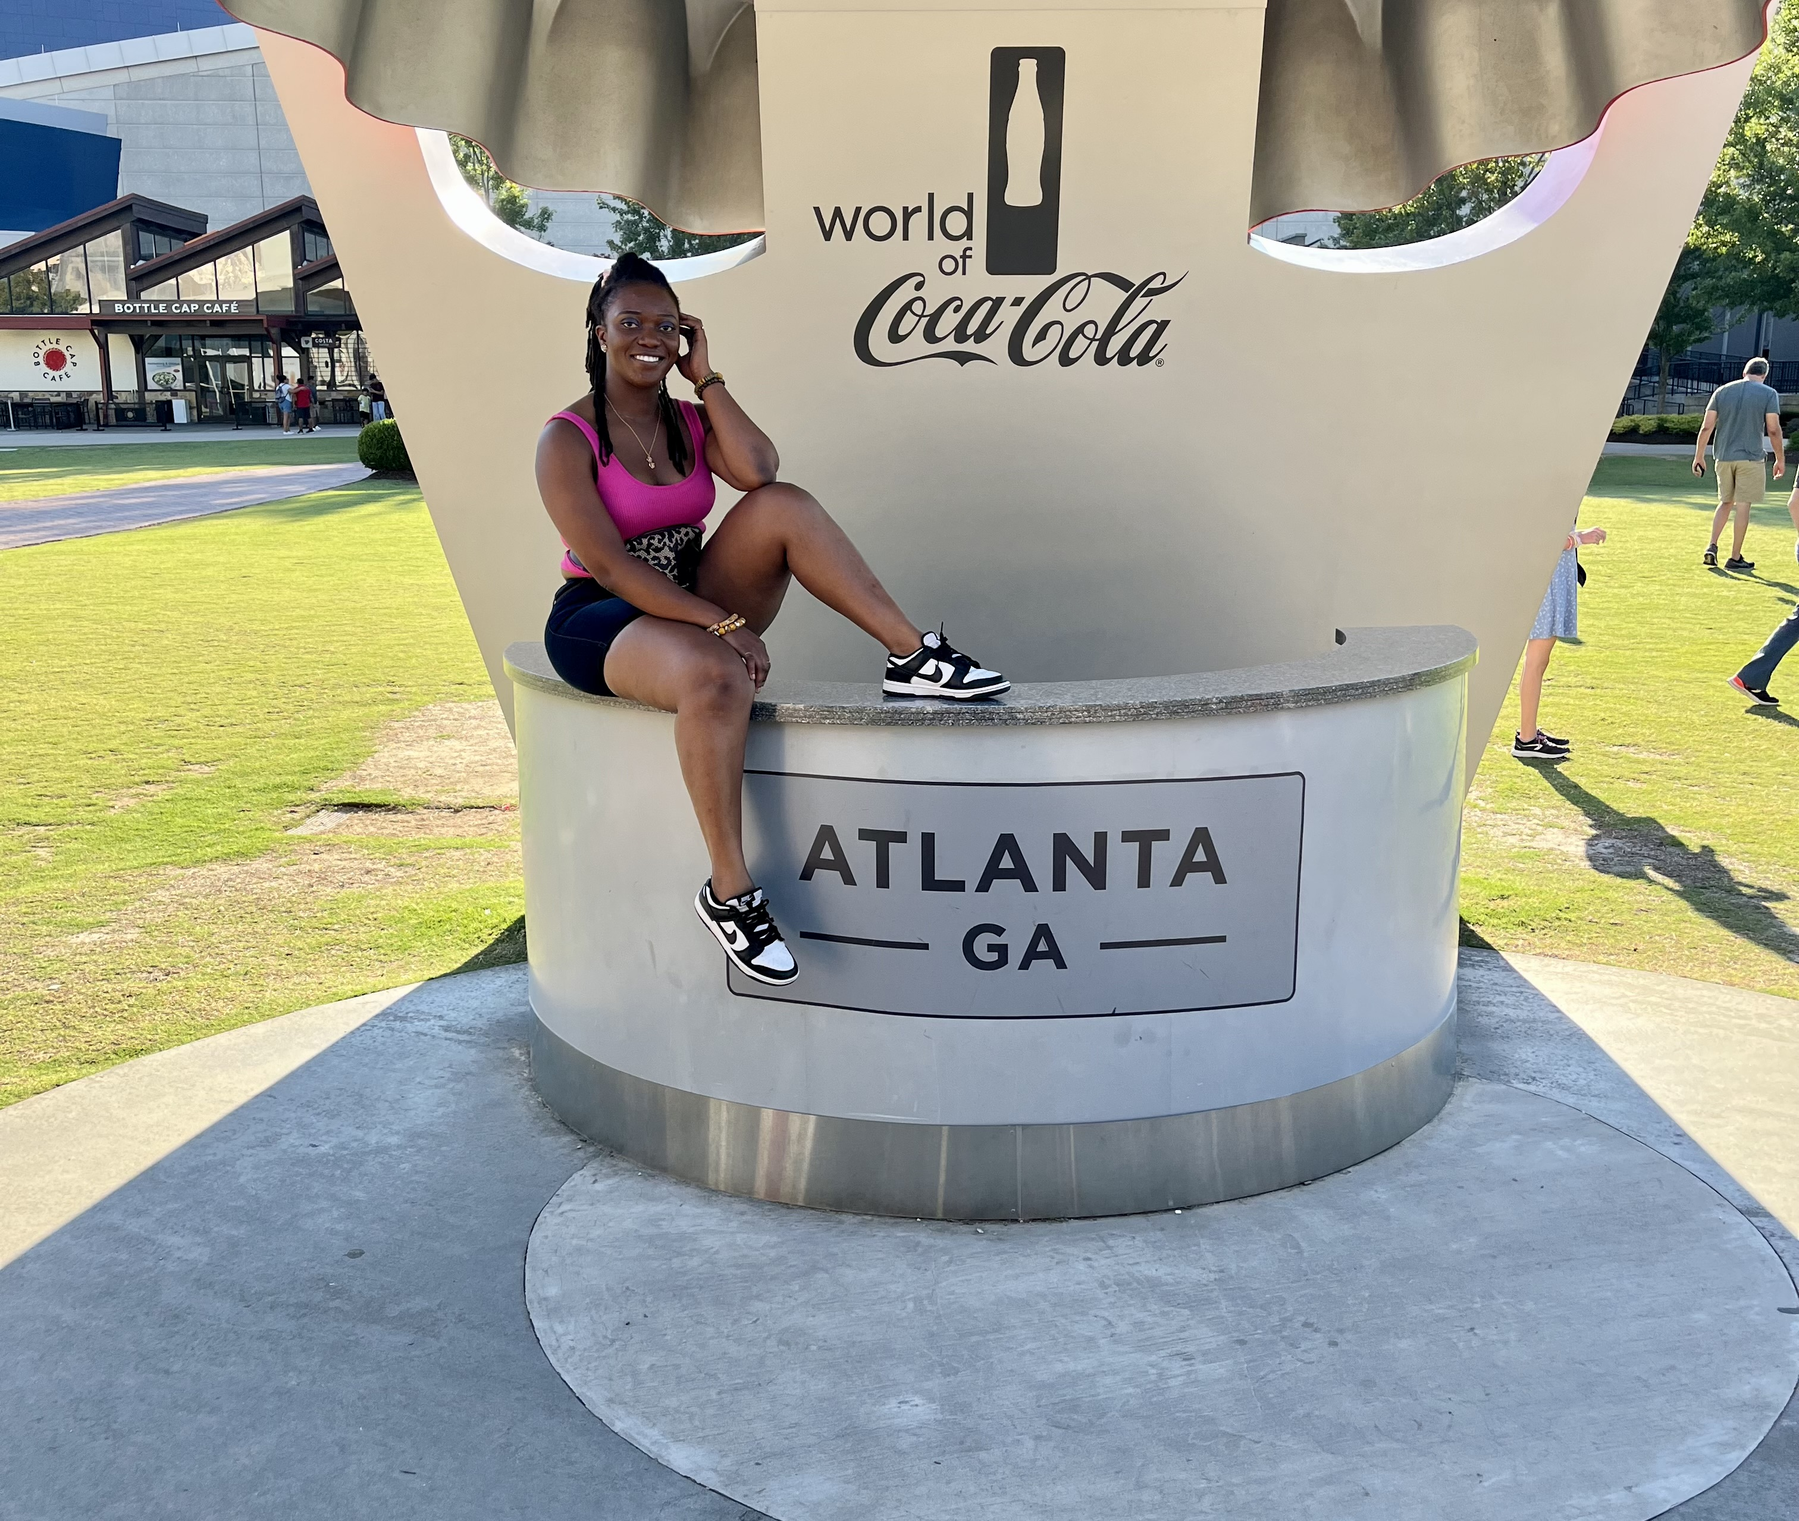
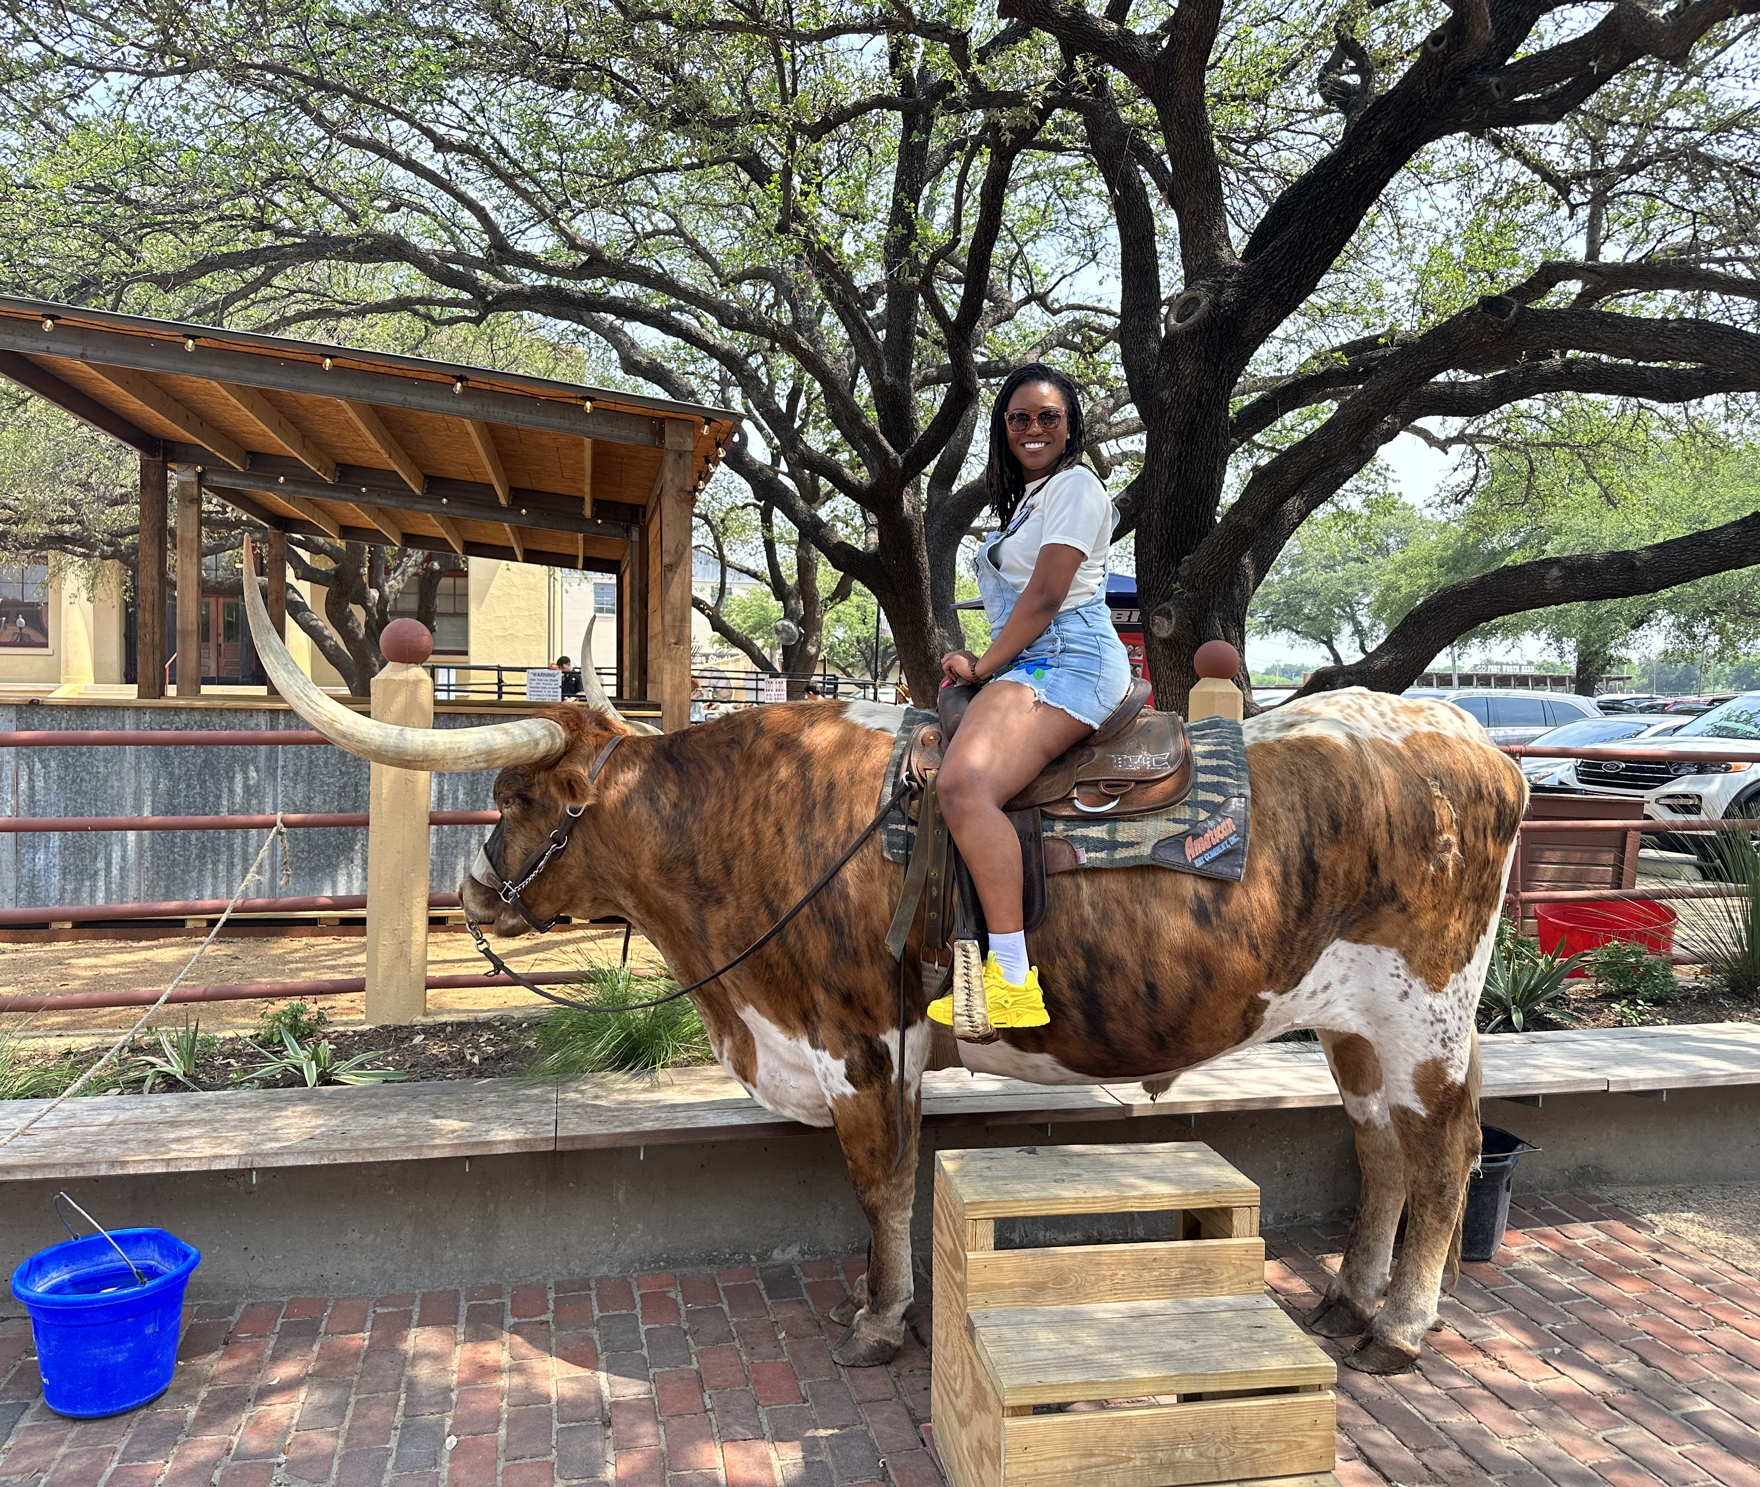
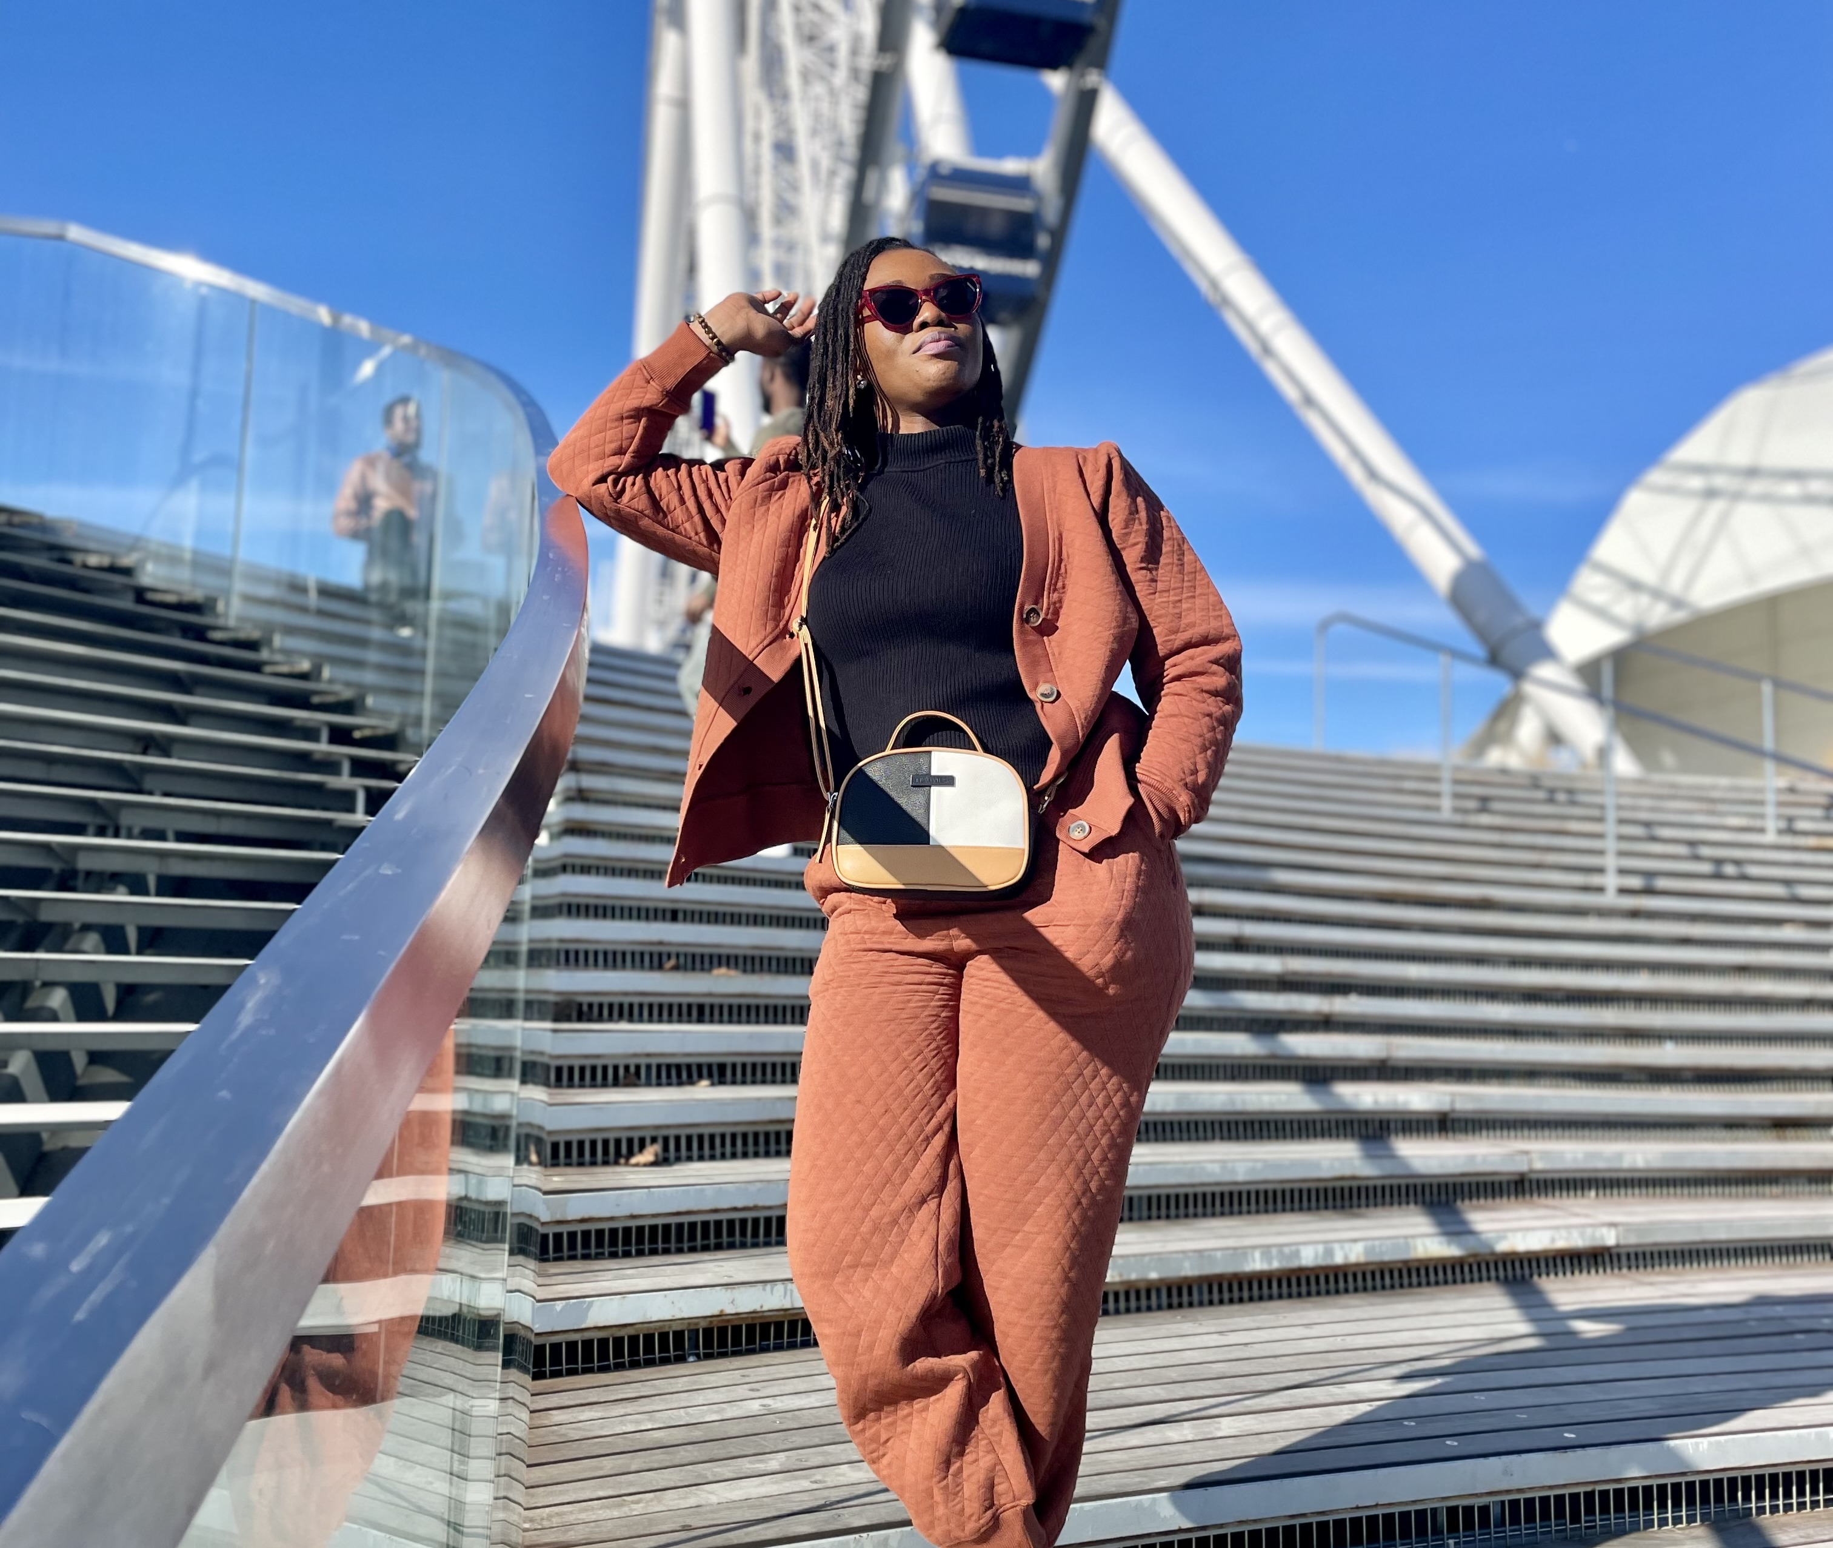
Outside the classroom/Workspace
Philippines
ATL
Dallas, TX
Chicago

